Slide 1
AAWR Advocacy
Advocating For Our Future
Lori Deitte, MD FACR FAAR
Vice Chair of Education, Vice President Continuous Professional Development
Vanderbilt University Medical Center
Co-chair AAWR Advocacy Committee
Member AAWR Board and Executive Committee
Lori.deitte@vumc.org

Slide 2
AAWR Advocacy Committee
Co-chairs: Kirti Magudia, Lori Deitte
Elizabeth Arleo
Alexandria Atkins
Sarah Averill
Sarah Beltron-Ponce
Elizabeth Dibble
Meredith Englander
Rachel Gerson
Yasha Gupta
Susan Hamman
Reshma Jagsi
Amy Kotsenas
Sasha Kurumety
Geraldine McGinty
Thomas Ng
Kristin Porter
Gaurang Shah
Sonia Samant
Anna Sophia McKenny
Eulanca Liu
Priscilla Slanetz
Rachel Preisser
Alena Khalil
Oyku Barut
Shanna Matalon
Melissa Reichman

Slide 3
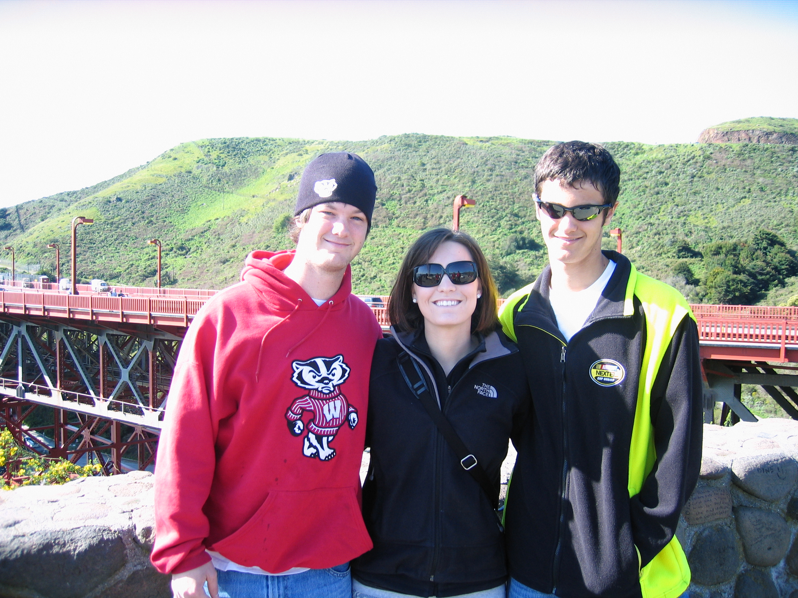
Family & Medical Leave Advocacy: My “Why”
August, first year of residency
June, end of fellowship
May, second year of PP

Slide 4
AAWR Advocacy
Early AAWR advocacy initiatives

Slide 5
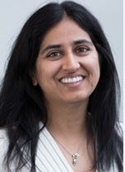
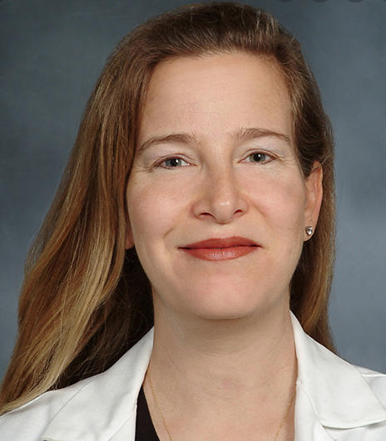
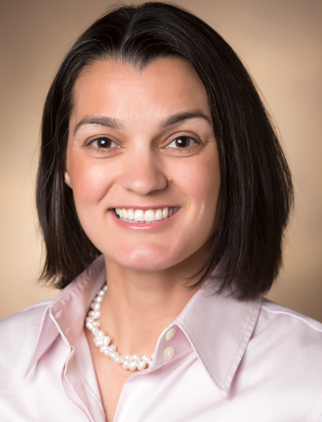
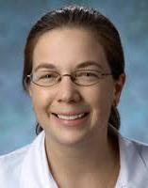
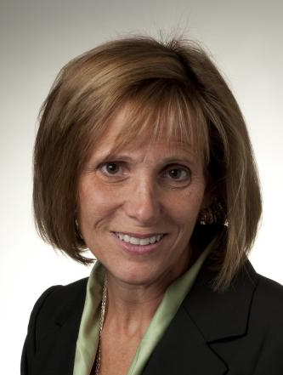
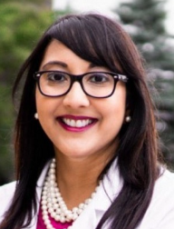
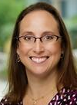

AAWR Advocacy: FML/PFML
2019: Paid Parental Leave in Radiology: The Time is Now (Arleo)
2019-2020: SCARD, ABR, APDR and ABMS policies and statements
2021: ABR Resident Leave Policy, AAWR amendment ACR Res 48
2022: AAWR ACR Resolution 13 passage

Slide 6
April 2022: ACR Council Passes Resolution 13!
Paid Family and Medical Leave
The ACR recommends that practices and departments strive to provide 12 weeks paid family/medical
leave in a 12-month period

Slide 7
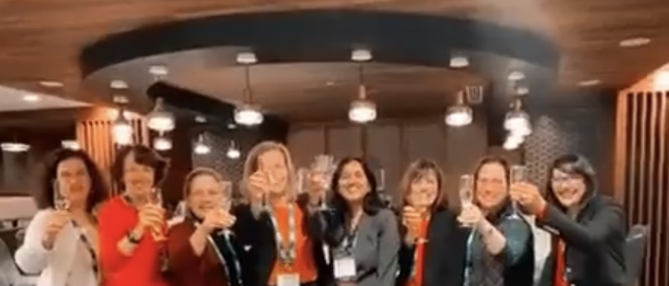
AAWR Advocacy
A huge AAWR advocacy “win”:
celebrating the passage of Resolution 13!

Slide 8
2023: Formation of the AAWR Advocacy Committee
Paid Family and Medical Leave Resources Webpage
Webpage went live in March 2024
Includes historical background, links to resources, multiple FAQs with links, tab for comments/suggestions
Socializing through posting the link on organizational websites (ACR, APDR, ASNR), social media postings, webinars, announcements, and annual meetings

Slide 9
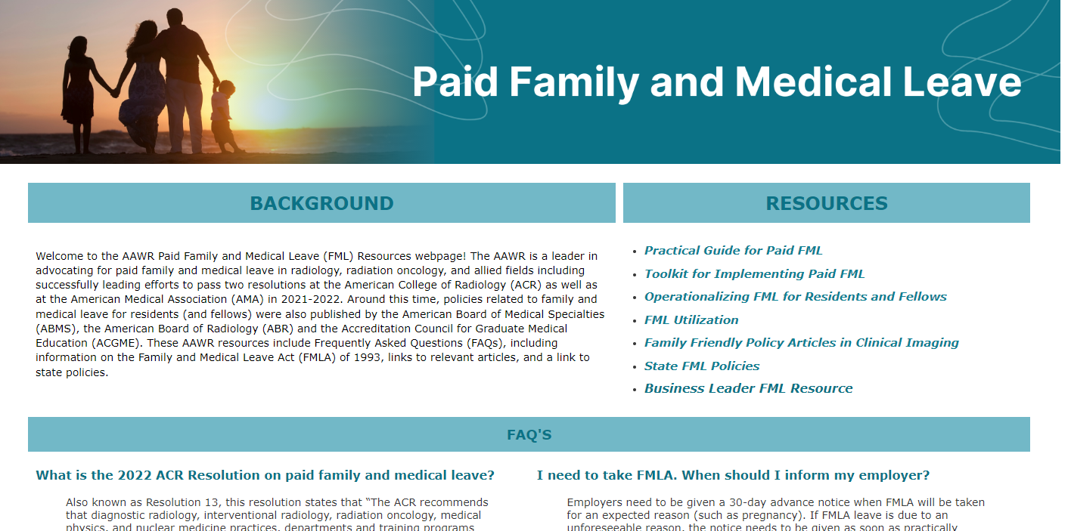
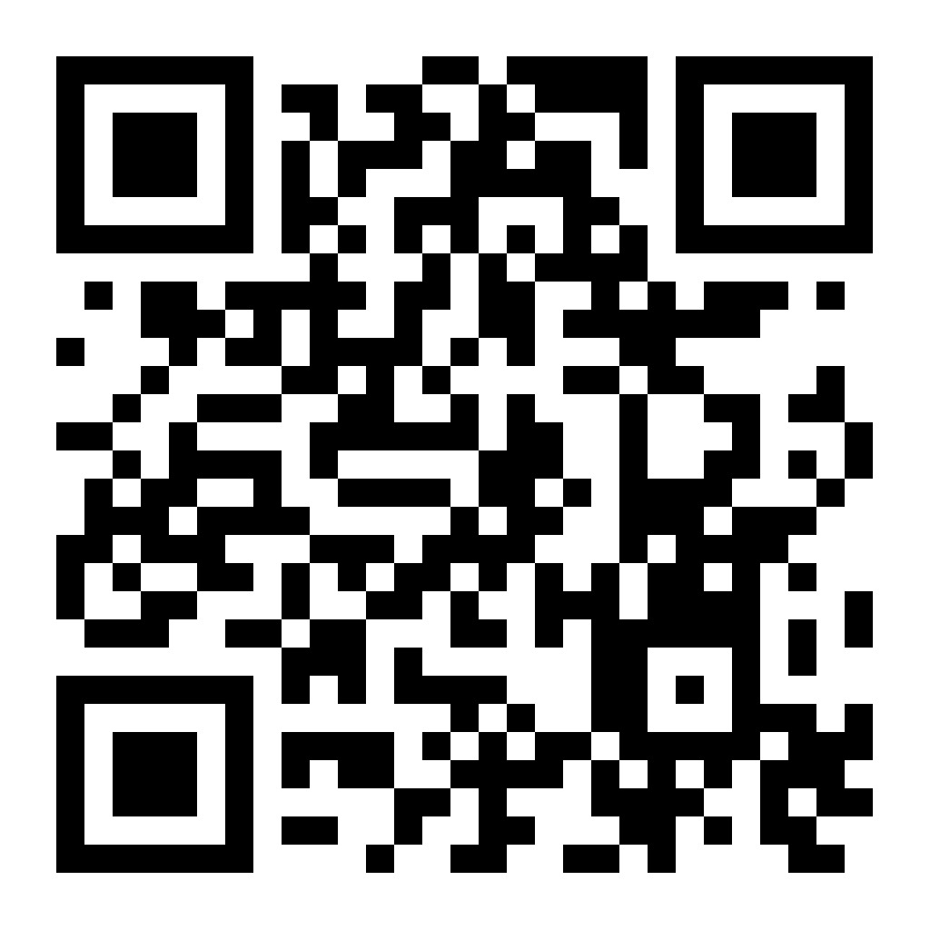
https://www.aawr.org/Paid-Family/Medical-Leave

Slide 10
AAWR Advocacy
Where are we now?

Slide 11
Paid Family and Medical Leave Survey:
AAWR Advocacy Committee, ACR, and SWRO
Deployed in late July 2024
Stratified sample ACR members
AAWR and SWRO members
Duplicative responses removed
Respondents: academic, private practice, hospital-based, private equity owned, VA, and others
Kirti Magudia
Co-chair AAWR Advocacy Committee

Slide 12
Acknowledgements for ACR/AAWR/SWRO Survey
Kirti Magudia
Elizabeth Arleo
Elizabeth Dibble
Thomas Ng
Claire Baniel
Sara Beltran Ponce
Olga Laur
Susan Hamman
Rachel Lee
Candice Johnstone
Johnson Lightfoote
Eric Rubin
Jay Parikh
Reshma Jagsi
Amy Kotsenas
Rachel Lee
Dominick Parris
Jo Tarrant

Slide 13
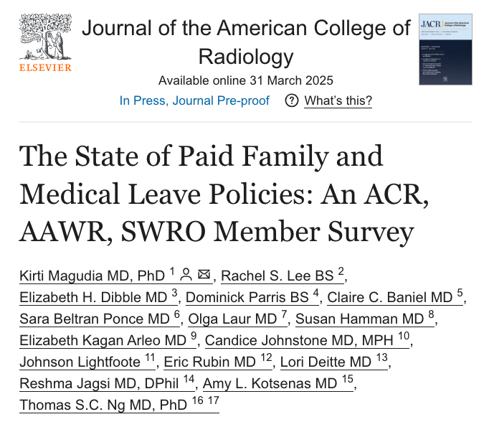

Slide 14
The ACR/AAWR/SWRO survey article titled The State of Paid Family and Medical Leave Policies: An ACR, AAWR, SWRO Member Survey is available online at: https://authors.elsevier.com/a/1k%7ERX5VZMrOR-Y

Slide 15
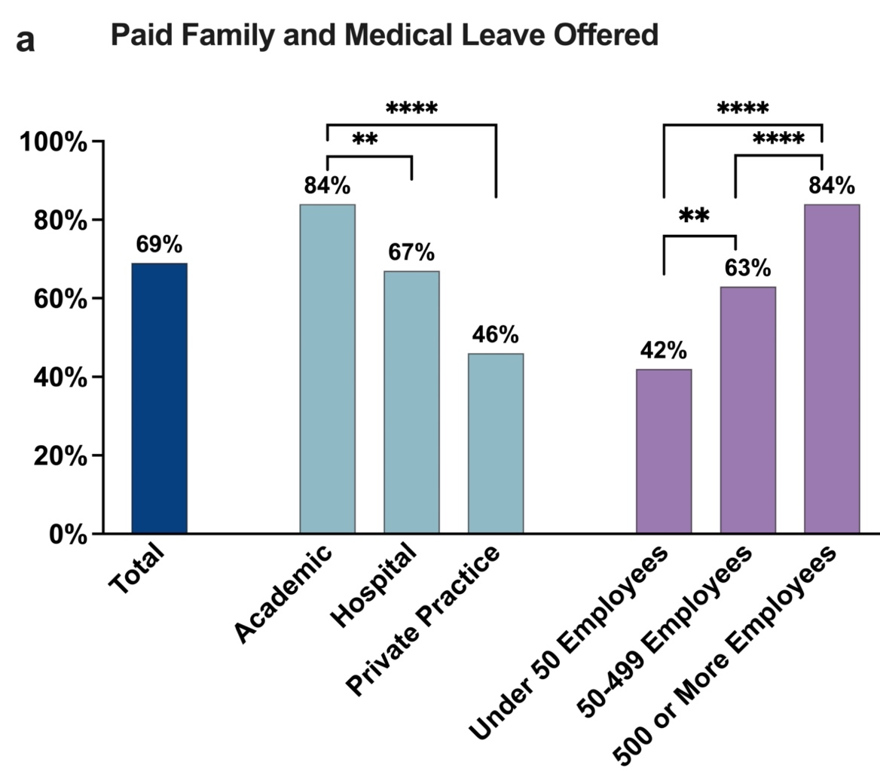
PFML Offered

Slide 16
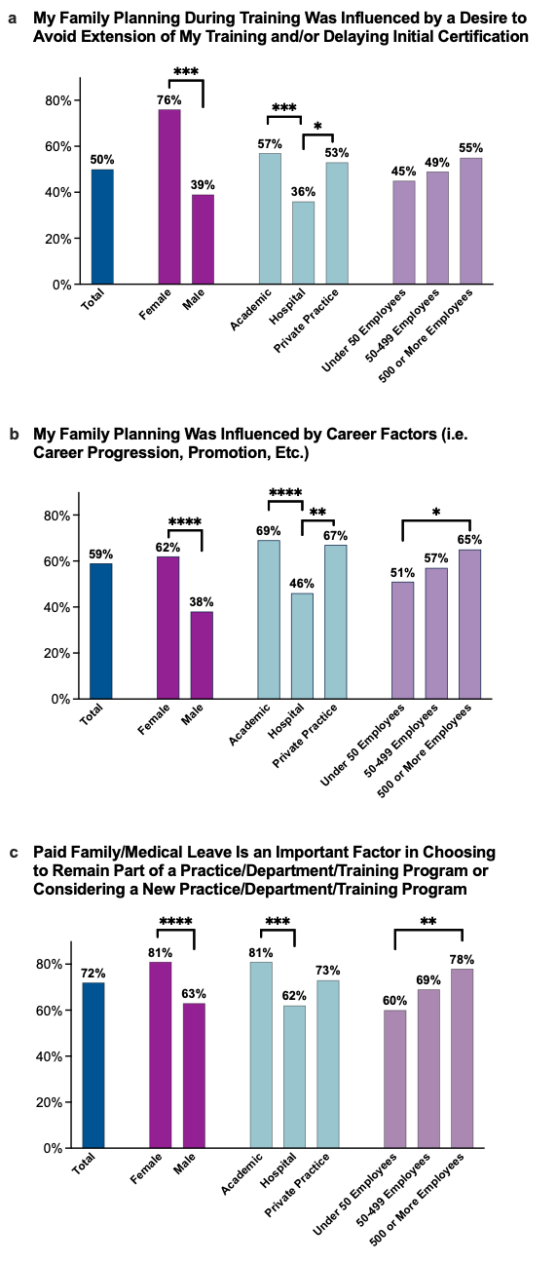
PFML is an Important Factor in Choosing to Remain Part of or Considering a New Practice/Department or Training Program

Slide 17
Conclusions
ACR council passed two resolutions in favor of FML/PFML
PFML is widely available, including nearly half of private practices
PFML is an important workforce issue when radiologists are deciding to stay at a practice or are considering a new practice

Slide 18
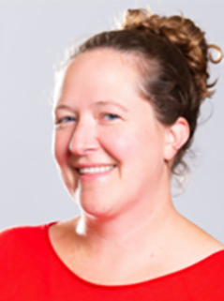
Presentation to the ACR Council on Tuesday!
Kirti Magudia, MD PhD
Co-chair AAWR Advocacy Committee
Elizabeth Dibble, MD AAWR Advocacy Committee, ACR Commission on Human Resources

Slide 19
Other AAWR Advocacy Committee Activities
Passage of Resolution 60 (affirms that abortion is an essential component of healthcare) at the 2024 ACR meeting
ASNR/AAWR Joint Webinar on PFML on 2/5/2025
AAWR Formal Statement on PFML spearheaded by Melissa Reichman, approved by the board on 4/28/2025

Slide 20
AAWR Official Statement on PFML
In accordance with the ACR, the American Association for Women Radiologists (AAWR) recommends that diagnostic radiology, interventional radiology, radiation oncology, medical physics, and nuclear medicine departments, practices and training programs provide a minimum of 12 weeks of paid family/medical leave within a 12-month period for attending physicians, medical physicists and trainees.

Slide 21
AAWR Advocacy
Where are we going?

Slide 22
AAWR Future Directions: PFML
Add field for PFML policies to job boards (yes/no, details)
Further research on policies at academic institutions through SCARD and SCAROP
Identify PFML success stories, especially in private practice; please send to kirti.magudia@duke.edu, Lori.deitte@vumc.org, or edibble@brownhealth.org

Slide 23
AAWR Future Directions: Pay Equity & Workforce
Co-chaired by Susan Hammerman & Priscilla Slanetz
Focus is on pay inequity prevalence, transparency, types and variability of practices, part-time/fulltime
Will likely develop a short survey
Considering a future ACR resolution

Slide 24
AAWR Future Directions: Firearm Safety
Co-chaired by Sarah Averill & Sonia Samant
Focus is on gun violence and threats against hospitals and outpatient clinics
Considering a future ACR resolution
Of note, in 2015 the BOC sponsored Resolution 99 “The ACR recognizes that deaths and injuries related to firearms are a major Health concern”

Slide 25

You are invited
to reflect on today’s session and join us as we advocate for our future together!
Thank you
Lori Deitte, MD FACR FAAR
Lori.deitte@vumc.org

